Slide 2
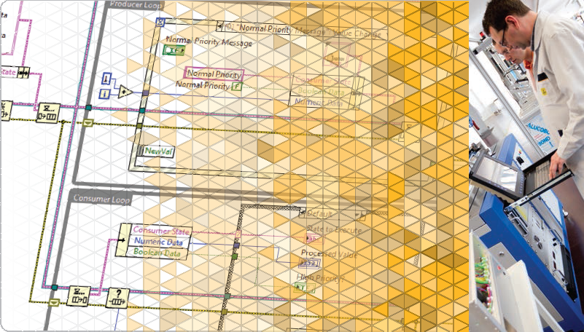
LabVIEW Core 2

Slide 3
Welcome to LabVIEW Core 2
Course Learning Map
Lesson 1
Implementing Design Patterns
Lesson 4
Lesson 2
Using Variables
Communicating Data Between Parallel Loops
Lesson 3
Controlling the User Interface
Lesson 5
Creating and Distributing Applications
Lesson 6
File I/O Techniques
Improving an Existing VI
Lesson 7

Slide 4
Lesson 3
Implementing Design Patterns
Implement common design patterns for single and parallel loop applications.
Why Use Design Patterns?
Simple Design Patterns
Multiple Loop Design Patterns
Functional Global Variable Design Pattern
Error Handlers
Generating Error Codes and Messages
Timing a Design Pattern

Slide 5
D. Functional Global Variable Design Pattern
Describe and use the functional global variable design pattern.
Functional Global Variables
Timer FGVs

Slide 6
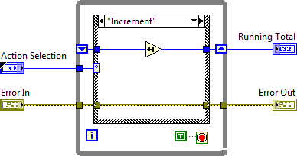
Functional Global Variables

Slide 7
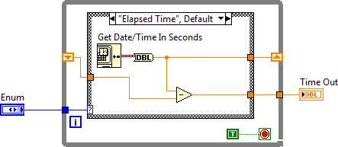
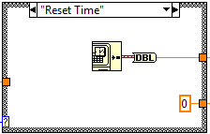
D. Functional Global Variables
Timer FGVs

Slide 8
Exercise 3-2
Create a User Access Level FGV
Create an FGV to determine user access based on user access level.

Slide 9
Exercise 3-2
Create a User Access Level FGV
What is the purpose of the Get Current Access Level operation?
How would you modify the FGV so that you can update the User Access Levels.txt through the user interface?
Notes:
What is the purpose of the Get Current Access Level operation?
Some students might be wondering why we have a separate Get Current Access Level operation since the Set Current Access Level operation returns the User Access Level. Typically, the Set Current Access Level is called when a user logs into the system, typically during application initialization. After initialization, there might be special diagnostic tests or other application features which should be locked or unlocked depending on the User Access Level. Therefore, in other parts of the application, you only want to know the current user access level. You do not want to be specifying the User Name again.
How would you modify the FGV so that you can update the User Access Levels.txt through the user interface?
Add another case to Write User Access Level which writes a User Name and Access Level to the User Access Levels.txt file. Add another value to the User level Cmd enum.

Slide 10
Activity 3-1
Identifying Design Patterns
Based on the scenario, identify the design pattern that you would use to implement that application.

Slide 11
Activity 3-2
Design Patterns Job Aid
Review the uses, advantages, and disadvantages for various design patterns.

Slide 12
E. Error Handlers
Use error handlers in design patterns to manage code execution when an error occurs.
Examples of Error Handlers
Producer/Consumer Error Handling

Slide 13




E. Error Handlers
Examples of Error Handlers
Simple Error Handler VI
General Error Handler VI
State machine error handler
Error Handler—A VI or code that changes normal flow of program execution when an error occurs

Slide 14
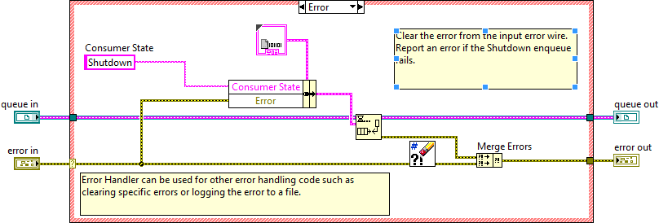
Producer Consumer Error Handler VI
Examine the Producer Consumer design pattern with an Error Handler VI.

Slide 15
F. Generating Error Codes and Messages
Use error codes and messages in design patterns.
Error Reporting Options
Error Ring

Slide 16

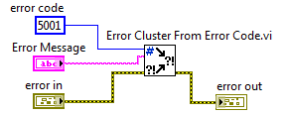
F. Generating Error Codes and Messages
Error Reporting Options
Notes:
Report invalid inputs to subVIs such as empty string, path, reference. Or report a number out of a valid range. For example, to prevent taking the square root of a negative number, check input value first. If the input value is negative, force an error condition.
Report file and resource errors, such as file/folder not found or an invalid file format. For example, if a file is not found or after reading file the contents of the file are not valid, report a file error. Suggest the user check the file contents.
You might also want to override LabVIEW-generated messages. Sometimes LV-generated error messages are not specific enough. After detecting a LabVIEW error, program the code to display a user-defined error with a more descriptive message.

Slide 17
Use the Error Ring to Generate Errors
Demonstrate use of the Error Ring to select and create errors.
Generate pre-defined error codes and messages.
Generate user-defined error codes and messages.

Slide 18
Exercise 3-3
Producer/Consumer with Error Handling
Use buttons to inject errors in the program so you can test the error handling code.

Slide 19
Exercise 3-3
Producer/Consumer with Error Handling
The error wire in the producer loop is branched before the Error Handler.vi. In the consumer loop it is branched after the Error Handler. Why?
Are there situations which would cause this error handling approach to fail?

Slide 20
G. Timing a Design Pattern
Use timing functions in design patterns.
Execution Timing
Software Control Timing

Slide 21
G. Timing a Design Pattern
Execution and Software Control Timing
Execution Timing
Allows the processor time to complete other tasks.
Software Control Timing
Times a real-world operation to perform within a set time period.
Controls the frequency at which a loop executes.

Slide 22
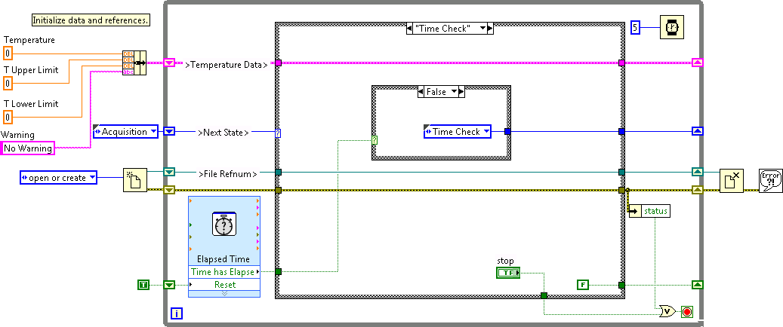
G. Timing a Design Pattern
Execution and Software Control Timing
Execution Timing
Software Control Timing

Slide 23
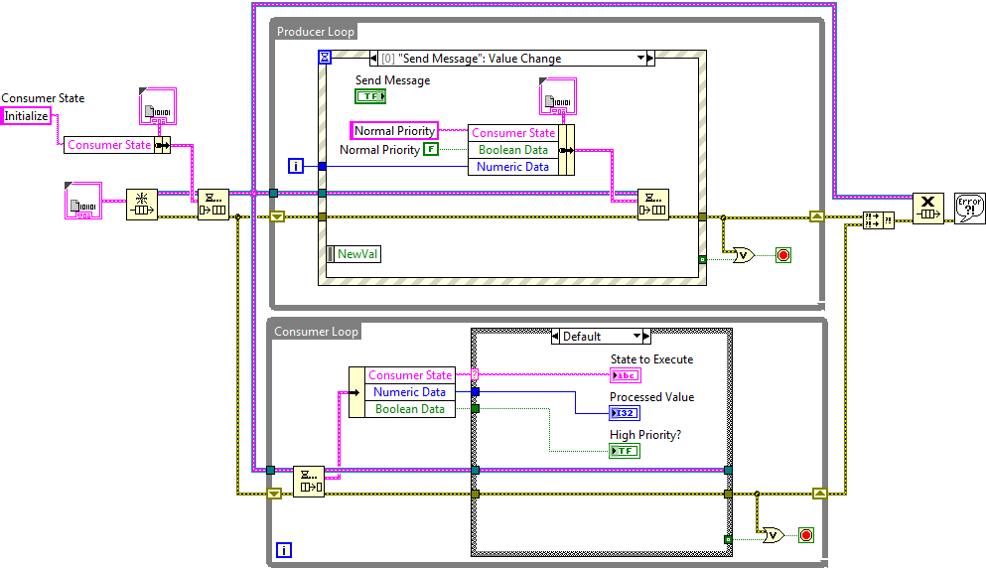
G. Timing a Design Pattern
Execution Timing
Default Timeout =-1, Wait Indefinitely
Notes:
When you implement design patterns where the timing is based on the occurrence of events, you do not have to determine the correct timing frequency because the execution of the design pattern only occurs when an event occurs. In other words, the design pattern only executes when it receives an event. For example, the producer/consumer (Events) VI shown above does not require any timing functions because the timing is inherent in the implementation of the producer loop and the consumer loop. The Event structure in the producer loop controls when the producer loop executes. The Dequeue Element function in the consumer loop waits until an item is placed in the queue, thus controlling the execution of the consumer loop. Design patterns such as the producer/consumer (Events) do not require any timing because their timing is controlled by external events.

Slide 24


G. Timing a Design Pattern
Execution Timing Functions
Wait (ms)
Wait Until Next ms Multiple

Slide 25
G. Timing a Design Pattern
Software Control Timing
Software control timing must allow the design pattern to run continuously without stopping.
Two approaches:
Functional Timeout
Timestamps
Notes:
In LabVIEW Core 1 you learned to use the Wait (ms) and the Wait Until Next ms Multiple to perform software control timing.
While these are suitable for execution timing, these are not the preferred method for performing software control timing.
One alternative is to use the timeout functionality associated with Events and Queues (see next slide).

Slide 26
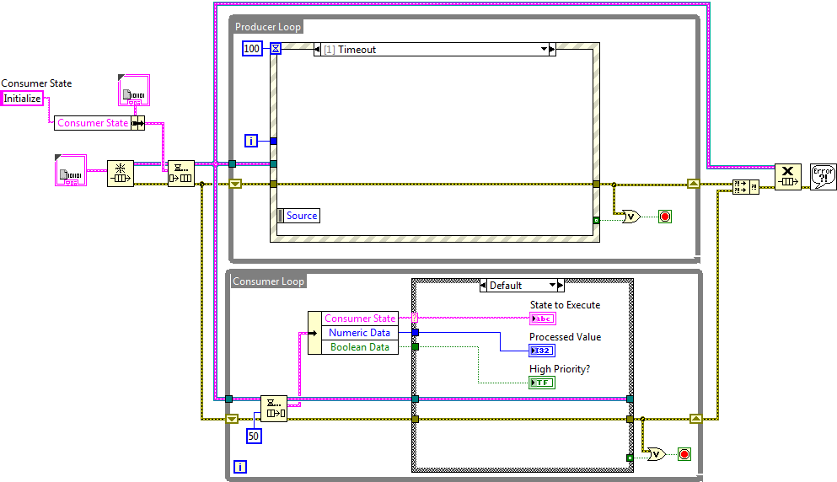
G. Timing a Design Pattern
Functional Timeout
Timeout in ms

Slide 27



G. Timing a Design Pattern
Obtaining Timestamps
Tick Count (ms)
High Resolution Relative Seconds
Get Date/Time in Seconds
Notes:
The Tick Count runs the risk of roll over.

Slide 28
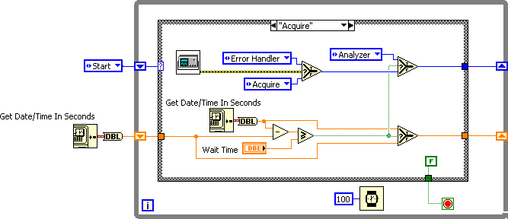
G. Timing a Design Pattern
Get Date/Time in Seconds
Use the Get Date/Time In Seconds function for working with elapsed times.

Slide 29
Activity 3-3
Identifying Timing Options
Determine whether each scenario indicates a need for execution timing or software control timing.

Slide 30
Exercise 3-4
Create a Histogram Application
Create a histogram application using the Producer/Consumer template.

Slide 31
Exercise 3-4
Create a Histogram Application
What happened to the backlog when the File Dialog box was open?
In the Snapshot Value Change event case, “Snapshot” is enqueued at the front of the queue, not the back. Why?
Notes:
What happened to the backlog when the File Dialog function was open?
The backlog continued to increase. This is because the File Dialog function blocked the processing of the data. After the File Dialog closed, the consumer loop quickly processed all the backlog of data.
In the Snapshot Value Change event case, “Snapshot” is enqueued at the front of the queue, not the back. Why?
A snapshot is most accurate if captured at the moment in time the user selects. If there was a backlog of data and the snapshot event was enqueued at the back of the queue, then it is possible the data logged to file would not match the user’s selection.

Slide 32

Activity 3-4
Lesson Review
Refer to the participant guide to answer questions about what you have learned in this lesson and then discuss the answers as a group.

Slide 33
1. Which of the following are reasons for using a multiple loop design pattern?
Execute multiple tasks concurrently
Execute different states in a state machine
Execute tasks at different rates
Execute start up code, main loop, and shutdown code
Notes:
Answer is a and c.

Slide 34
1. Which of the following are reasons for using a multiple loop design pattern?
Execute multiple tasks concurrently
Execute different states in a state machine
Execute tasks at different rates
Execute start up code, main loop, and shutdown code

Slide 35
2. Which of the following are examples of error handling code?
Displays a dialog box used to correct a broken VI
Generates a user-defined error code
Displays a dialog box when an error occurs
Transitions a state machine to a shutdown state when an error occurs
Notes:
Answer is c and d.

Slide 36
2. Which of the following are examples of error handling code?
Displays a dialog box used to correct a broken VI
Generates a user-defined error code
Displays a dialog box when an error occurs
Transitions a state machine to a shutdown state when an error occurs
Notes:
An error handler is a VI or code that changes normal flow of program execution when an error occurs.
Examples include:
Simple Error Handler VI—Displays a dialog box with error information when an error occurs.
State machine error handler—Transitions the state machine to an error or shutdown state when an error occurs.
The following are not examples of error handling code:
Error ring—Use to generate an NI or user-defined error codes. Typically this is generated outside of an error handler.
Error list window—Displays the errors and warnings used to correct a broken VI and to debug an executable VI.

Slide 37
Lesson 4
Controlling the User Interface
Use property nodes, invoke nodes, and control references to programmatically control front panel objects.
VI Server Architecture
Property Nodes
Invoke Nodes
Control References

Slide 38
A. VI Server Architecture
Describe the purpose of the VI Server and the class hierarchy of properties and methods.
VI Server Purpose and Use
Properties and Methods
VI Class Hierarchy

Slide 39
A. VI Server Architecture
VI Server Purpose and Use
Provides programmatic access to LabVIEW
Use the VI Server to:
Programmatically control front panel objects and VIs
Dynamically load and call VIs
Run VIs on a computer or remotely across a network
Programmatically access the LabVIEW environment and editor (Scripting)

Slide 40
A. VI Server Architecture
Properties and Methods
Properties—Single-valued attributes of the object: read/write, read only, write only
Methods—Functions that operate on the object

Slide 41

A. VI Server Architecture
VI Server—Class Hierarchy
Control
Boolean
Array
Numeric
Class
Property: Visible
Method: Reinitialize to Default
Sub-Class
Property: Boolean Text
Object
Property Values
Label Text: Stop Button
Visible: Yes
Boolean Text: Stop
Notes:
Limit discussion to the very basics of object-oriented design.
VI Server has an object-oriented architecture. Each object that is a part of VI Server is a part of a class. The class that the object is a part of determines what properties and methods are available. For example, there is a control class and a VI class. There are also sub-classes for the control class where the objects are defined by what data type they are. For example, there are Boolean and array sub-classes.
Explain:
An object is a member of a class.
A class defines the object type, what an object is able to do, what operations it can perform (methods), and what properties it has.
Methods perform an operation on an object (just like a function or subVI).
Properties are the attributes of an object (color, plot style, labels, etc.).

Slide 42
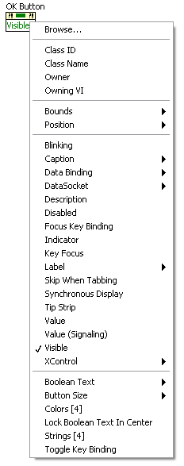
A. VI Server Architecture
Class Hierarchy
Generic
Generic
Control
Boolean
GraphChart
Numeric
Cluster
Etc.
GObject
VI
Application
Etc.
GObject
Control
Boolean
Notes:
Explain that the Control class is actually a sub-class of GObject, which in turn is a sub-class of Generic. Generic is a top class that is part of VI Server.
As the students will see when they do the exercises, there are lots of properties listed for property nodes.
Show how the list of properties list is in Class Hierarchy order and that properties are inherited by each lower class. This is the reason that the list is not in alphabetical order.
There is a similar hierarchy of Methods, but it is shorter.
If time permits open the LabVIEW Help and show students the Property and Method Reference»VI Server Properties and Methods»VI Server Class Hierarchy.

Slide 43
B. Property Nodes
Describe how to create property nodes and explain execution order.
Definition
Creating Property Nodes
Execution Order

Slide 44


B. Property Nodes
Property Nodes
Read and write the properties of an object
Make modifications programmatically
Implicitly Linked
Explicitly Linked
Notes:
Explicitly linked property nodes are covered later in the lesson as part of the topic on control references. For now, just point out the visible differences between the two types of property nodes. Indicate that these are equivalent approaches.

Slide 45
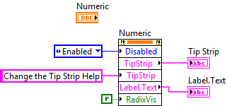
Using Property Nodes to Programmatically Control the User Interface
Use property nodes to change the characteristics of front panel objects.

Slide 46
Exercise 4-1
Display Temperature and Limits
Use Property Nodes to change the properties of front panel objects programmatically.

Slide 47
Exercise 4-1
Display Temperature and Limits
Why don’t we enable the controls in the Stop event case?

